Slide 1
HACK THE MEAL
CODE4U

Slide 2

Problem “How to satisfy customers of Kasarmina?”
Dishes served in Kasarmina should be suitable and tasty for everybody
Budget (how much money to spend on food services)

Slide 3


Solution
To shorten the quantity of thrown food
To get feedback from customers to erase the irrelevant dishes
Target audience: MAMK staff and students

Slide 4
How to…
file:///C:/Users/Inna/Desktop/HACKTHEMEALWEB/purchases.html

Slide 5
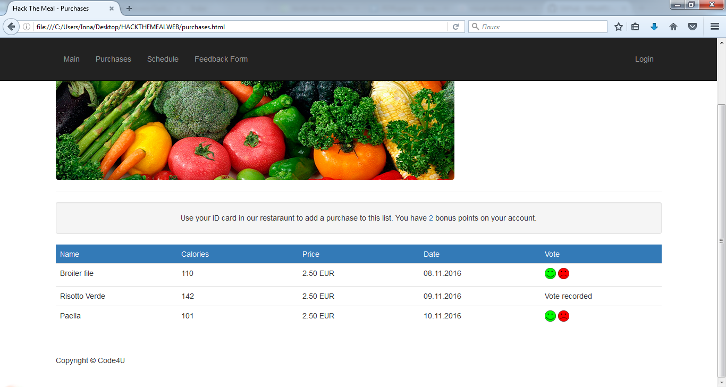
How to…

Slide 6
THANK YOU FOR YOUR ATTENTION!!

